Slide 1
Arming Small Security Programs
Security Onion Conference 2017

Slide 2
Arming Small Security Programs
Network baseline generation with Bropy

Slide 3
Disclaimer
I “borrowed” my employers slide template
Creating .POT files is hard
This is NOT my employers material
TLDR; You can sue me, not my employer

Slide 4

About Me
Matt Domko
Beard Enthusiast
Former:
Parachutist
Enterprise Admin
“Cyber Network Defender”
Instructor at Chiron Technology Services
Started blogging about Blue Team stuff
http://goo.gl/uznCag
Brakesec Slack
https://brakesec.signup.team
@hashtagcyber

Slide 5

Why I’m here
“Make the world a safer place” {by sharing information}

Slide 6
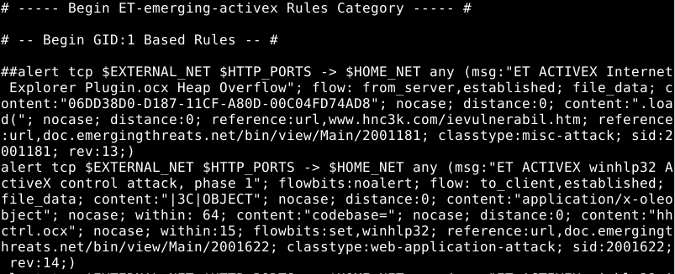
The Problem: Detecting Malicious Network Activity
Malicious network activity CAN be identified using signatures…

Slide 7
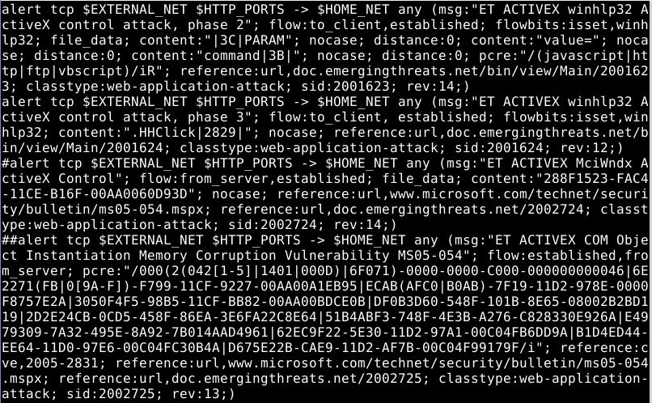
The Problem: Detecting Malicious Network Activity

Slide 8
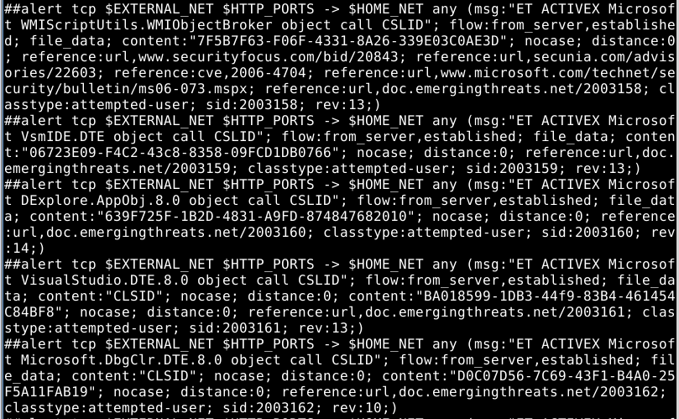
The Problem: Detecting Malicious Network Activity

Slide 9
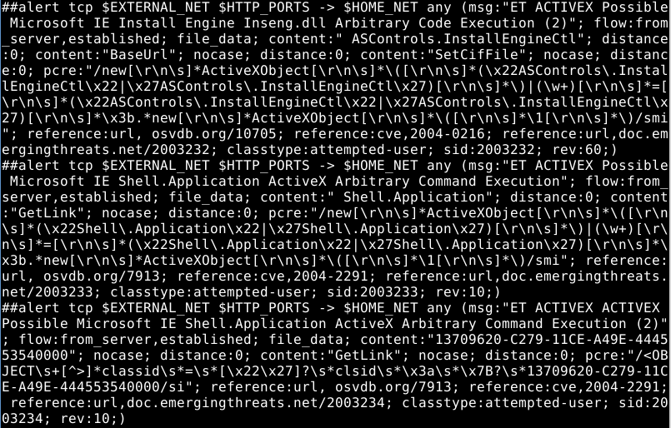
The Problem: Detecting Malicious Network Activity

Slide 10
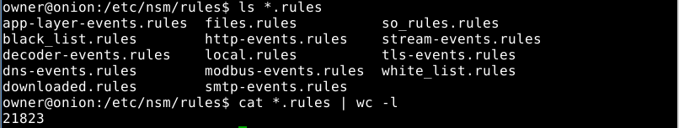
The Problem: Detecting Malicious Network Activity
And more signatures….
Fingerprinting EVERY attack is impossible
Signature based detection is USELESS if a signature does not exist for the attack being performed

Slide 11
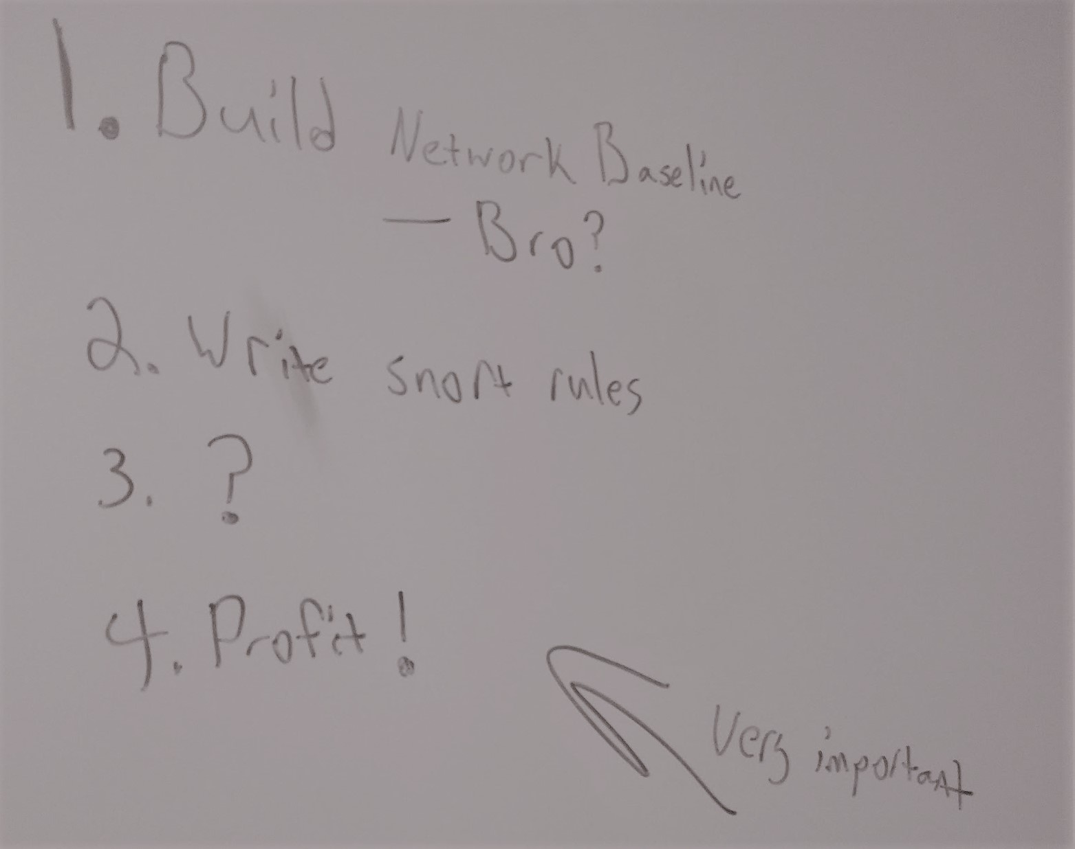
The Initial Idea

Slide 12
The Initial Idea
Step 1: Build a network baseline.
Bro?
Netflow?
Step 2: Write SNORT rules.
I need alerts for non-standard traffic
Step 3: ?
Something … Something … Something…
Step 4: Profit!
Or at least spend less time worrying

Slide 13
A Similar Problem: Malicious Binaries
Administrators face a similar problem with detecting malicious binaries.
Antivirus products initially only used file signatures to identify malware:
Evil Hashes
Ego Strings
Reused code blocks
This eventually failed, as attackers could easily modify malware to avoid signatures faster than they are generated
MSFVenom, Veil-Evasion, Hyperion

Slide 14
A Similar Problem: Malicious Binaries
Heuristic detection helped, but does it catch everything?
No. (Malware still exists/functions today)
What else can we do?
Enter Application Whitelisting

Slide 15
A Similar Problem: Malicious Binaries
Application Whitelisting provides ability to:
Log execution of all files except explicitly authorized (whitelist):
File Hashes (tedious)
File Names (poor protection)
Signed Code (Awesome)
Source Directory (simple)
Prevent execution of files that are not in the whitelist.
Prevent execution of explicitly defined files (Blacklisting)

Slide 16
Simple Application Whitelisting Implementation
Start with an empty whitelist
Apply a policy to log everything not in whitelist
Use logs to generate a whitelist
Modify policy to block everything not in whitelist
Review new logs
Investigate blocked files
Update whitelist as needed

Slide 17
Malicious Network Activity : Anomaly Detection
The same concept can be applied to network activity:
Start with an empty whitelist
Apply a policy to log all traffic not in the whitelist
Use logs to update the whitelist
Review new logs
Investigate new ports/hosts
Update whitelist as needed

Slide 18
But Matt, How Do I <do thing>?
Get data for my whitelist?
Bro.
Create a policy to log traffic?
Bro scripts
Create logs from new traffic?
Bro scripts
Review new logs?
Splunk, ELK, ELSA, Vi
Last question… Can you tell me more about Bro?

Slide 19
Gathering Data with Bro
Bro in 30 Seconds
Much more than an IDS
Logs multiple layers of traffic
“Packet String”
Similar to NETFLOW
Plugins/Scripts
Interpret Data
Take action
Logs are small
Allows for longer retention than PCAP
Open Source, Built-in to Security Onion

Slide 20
Gathering Data with Bro
Bro Data Formatting
Tab Separated table
Headers at top
Common Fields:
Timestamp (ts)
Connection ID (uid)
IP Source (id.orig_h)
Source Port (id.orig_p)
IP Destination (id.resp_h)
Dest Port (id.resp_p)

Slide 21
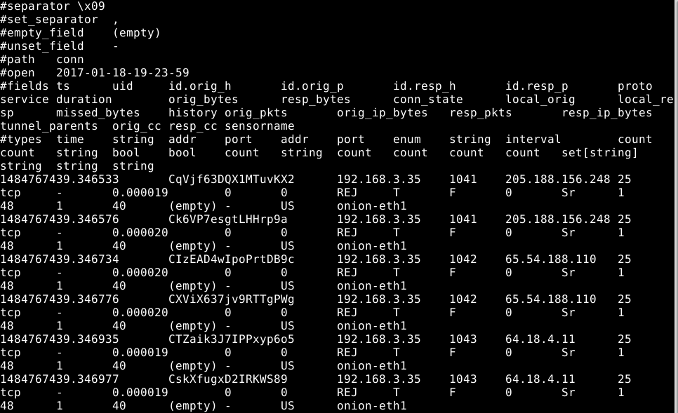
Gathering Data with Bro
Logs are simple to parse …. programmatically

Slide 22
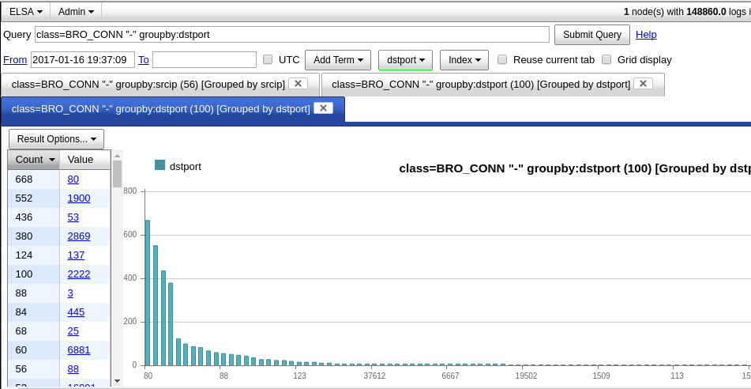
Gathering Data with Bro
Humans should use ELSA, Splunk, etc…

Slide 23
Gathering Data with Bro
Key Directories:
/nsm/bro/logs/current
notice.log
conn.log
weird.log
/opt/bro/share/bro/policy
Contains scripts loaded by Bro
/opt/bro/share/bro/site/local.bro
Add path to custom scripts to this file to load when bro starts

Slide 24
Bro Scripts
“The best way to learn to write Bro scripts, is to write Bro scripts”
Seth Hall, SecurityOnion Conference 2015

Slide 25
Bro Scripts
owner@onion:~/simple$ cat simple.bro global myports: set[port] = {21/tcp, 22/tcp, 0/icmp}; event bro_init() { print "Lets print myports."; print fmt ("There are %d in the list.", |myports|); for (x in myports) print x; } event new_connection(c:connection) { if (c$id$resp_p in myports) { print fmt("Port %s connection detected", c$id$resp_p); }; };
Bro Scripting

Slide 26
Bro Scripts
owner@onion:~/simple$ cat simple.bro global myports: set[port] = {21/tcp, 22/tcp, 0/icmp}; event bro_init() { print "Lets print myports."; print fmt ("There are %d in the list.", |myports|); for (x in myports) print x; } event new_connection(c:connection) { if (c$id$resp_p in myports) { print fmt("Port %s connection detected", c$id$resp_p); }; };
Bro Scripting
global myports: set[port] = {21/tcp, 22/tcp, 0/icmp};
#Create a list

Slide 27
Bro Scripts
owner@onion:~/simple$ cat simple.bro global myports: set[port] = {21/tcp, 22/tcp, 0/icmp}; event bro_init() { print "Lets print myports."; print fmt ("There are %d in the list.", |myports|); for (x in myports) print x; } event new_connection(c:connection) { if (c$id$resp_p in myports) { print fmt("Port %s connection detected", c$id$resp_p); }; };
Bro Scripting
event bro_init()
{
#Do stuff when Bro loads

Slide 28
Bro Scripts
owner@onion:~/simple$ cat simple.bro global myports: set[port] = {21/tcp, 22/tcp, 0/icmp}; event bro_init() { print "Lets print myports."; print fmt ("There are %d in the list.", |myports|); for (x in myports) print x; } event new_connection(c:connection) { if (c$id$resp_p in myports) { print fmt("Port %s connection detected", c$id$resp_p); }; };
Bro Scripting
print fmt ("There are %d in the list.", |myports|);
#Format string
# |var| gets length of list

Slide 29
Bro Scripts
event new_connection(c:connection)
{
# Do the thing in curley braces when Bro detects a new connection
owner@onion:~/simple$ cat simple.bro global myports: set[port] = {21/tcp, 22/tcp, 0/icmp}; event bro_init() { print "Lets print myports."; print fmt ("There are %d in the list.", |myports|); for (x in myports) print x; } event new_connection(c:connection) { if (c$id$resp_p in myports) { print fmt("Port %s connection detected", c$id$resp_p); }; };
Bro Scripting

Slide 30
Bro Scripts
if (c$id$resp_p in myports)
{
#If the destination port (c$id$resp_p) is in the list, do the thing in curley brackets
owner@onion:~/simple$ cat simple.bro global myports: set[port] = {21/tcp, 22/tcp, 0/icmp}; event bro_init() { print "Lets print myports."; print fmt ("There are %d in the list.", |myports|); for (x in myports) print x; } event new_connection(c:connection) { if (c$id$resp_p in myports) { print fmt("Port %s connection detected", c$id$resp_p); }; };
Bro Scripting

Slide 31
Something a little more useful…
Baselinereport.bro ::Pseudocode
Load table (baseline.data)
Check every new connection:
Is the destination on the baselined subnet?
If so, is it in the baseline?
If it’s in the baseline, is the source address allowed to use that port?
Log any “No’s”

Slide 32
Installing Baselinereport.bro
git clone https://github.com/hashtagcyber/baseliner.git
Edit line 32 of baselinereport.bro, replace with a comma separated list of subnets
Copy both files to /opt/bro/share/bro/policy/misc
Add “@load misc/baselinereport” to /opt/bro/share/bro/site/local.bro
Restart Bro

Slide 33
ELSA Demo
Useful search terms:
Show all notice’s generated by baselinereport
class=BRO_NOTICE "-" notice_type="TrafficBaselineException“
Show all connections to an IP, grouped by destination port
BRO_CONN.dstip=156.22.10.10 groupby:dstport
Show all connection to an IP/Port pair grouped by source IP
BRO_CONN.dstip=156.22.10.10 BRO_CONN.dstport=445 groupby:srcip

Slide 34
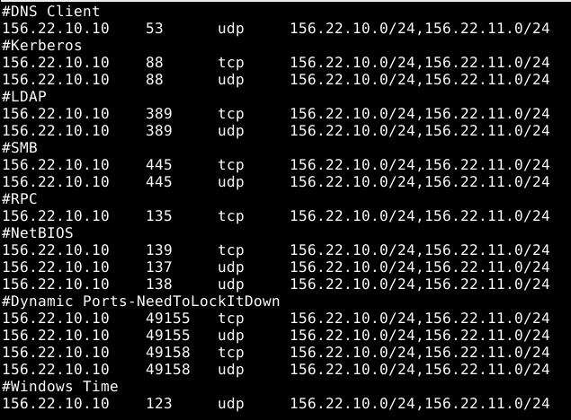
Updating Baseline w/ ELSa & VI

Slide 35
But ….
That sounds like a lot of work…

Slide 36
Bropy
Written in Python
Installs baselinereport.bro script
Parses notice.log
Generates network baseline automatically
Simple Yes/No interface

Slide 37
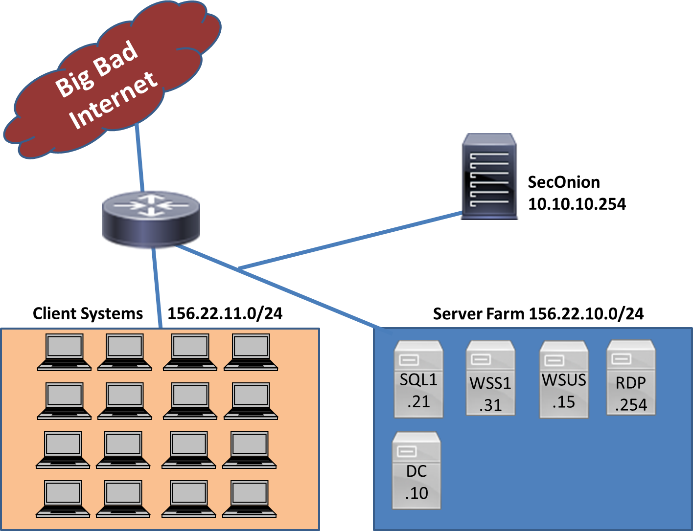
Scenario Network

Slide 38
Bropy
Demo Time

Slide 39
Bropy on SecurityOnion
git clone https://github.com/hashtagcyber/bropy
cd bropy
sudo ./bropy.py
Select option 3 to install
Enter the subnet and CIDR that you would like to monitor
Example: 156.22.10.0/24
Select Y to restart Bro
Wait for logs to be generated….
sudo ./bropy.py
Select option 1 to “Auto Baseline”
Select option 2 for Y/N prompting

Slide 40
Use Case
Generate a list of every port/protocol critical hosts receive connections on
Receive alerts when non-standard connections are detected
Baseline data can be used to generate firewall lists

Slide 41
Going Further
I’ve got a good baseline
I REALLY want to protect this asset
Can I do IPS functions?
How about honeypots?

Slide 42
Banhammer Branch
HoneyNet
HoneyRTR
EVIL
Edge RTR
Real
RTR
Assets

Slide 43
Banhammer Branch
HoneyNet
HoneyRTR
EVIL
Edge RTR
Bropy
Real
RTR
Assets

Slide 44
Banhammer Branch
HoneyNet
HoneyRTR
EVIL
Edge RTR
Evil Action
Bropy
Real
RTR
Assets

Slide 45
Banhammer Branch
HoneyNet
HoneyRTR
EVIL
That’s not in the baseline
Edge RTR
Evil Action
Bropy
Real
RTR
Assets

Slide 46
Banhammer Branch
HoneyNet
HoneyRTR
EVIL
SSH EDGE-RTR
route-map evil
Edge RTR
Evil Action
Bropy
Real
RTR
Assets

Slide 47
Banhammer Branch
HoneyNet
Evil Action
HoneyRTR
EVIL
Evil Action
Edge RTR
Evil Action
Bropy
Real
RTR
Assets

Slide 48
Questions?

